Slide 1
Cross-curricular projects
Mandarin中文
Lucy Zhang

Slide 2
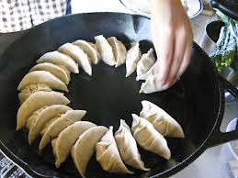
Some good practice from last year
With Modern Studies
With Home Economics
Cross-curricular
projects
With pupils, other colleagues at school and parents from community
With Music & Art & PE
With Modern Languages

Slide 3
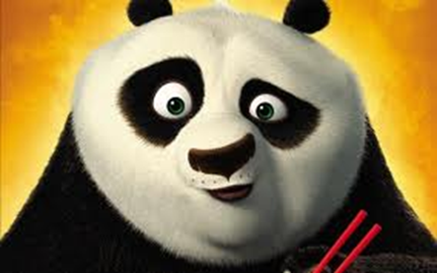
Things you need to prepare:
1 Find the links between Mandarin and other subjects
2 Discuss your ideas with your PT or other relevant colleagues
3 Get support from PT and other colleagues
4 Let pupils know the cross-curricular projects

Slide 4
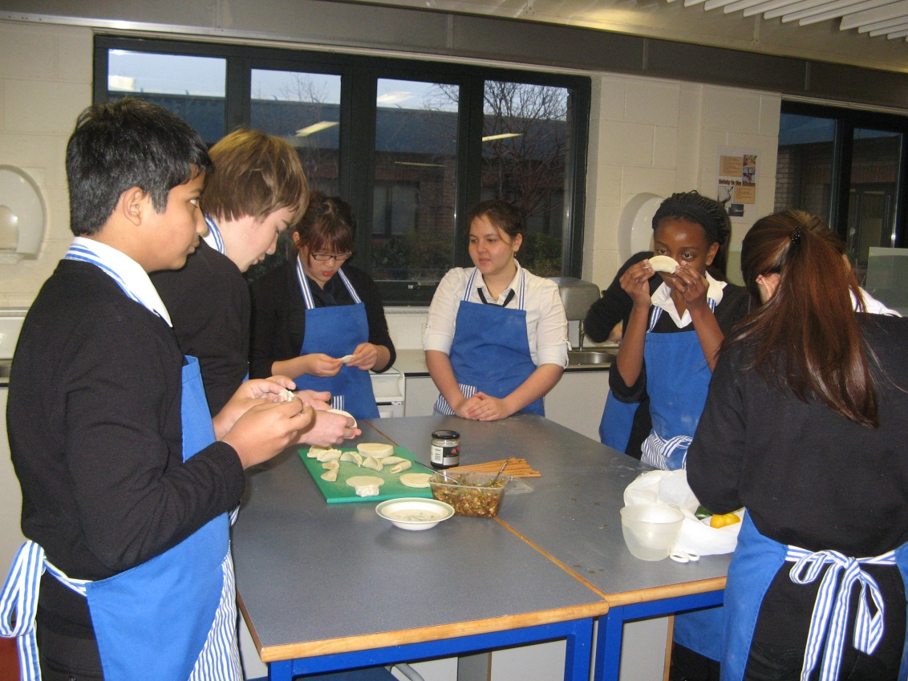
Example 1:
Making Chinese food
Why?
1 Pupils were learning Food & Drink in Mandarin
2 Enhance their interest
3 Attract more pupils who haven’t chosen Mandarin as
a subject
4 Work with HE department

Slide 5
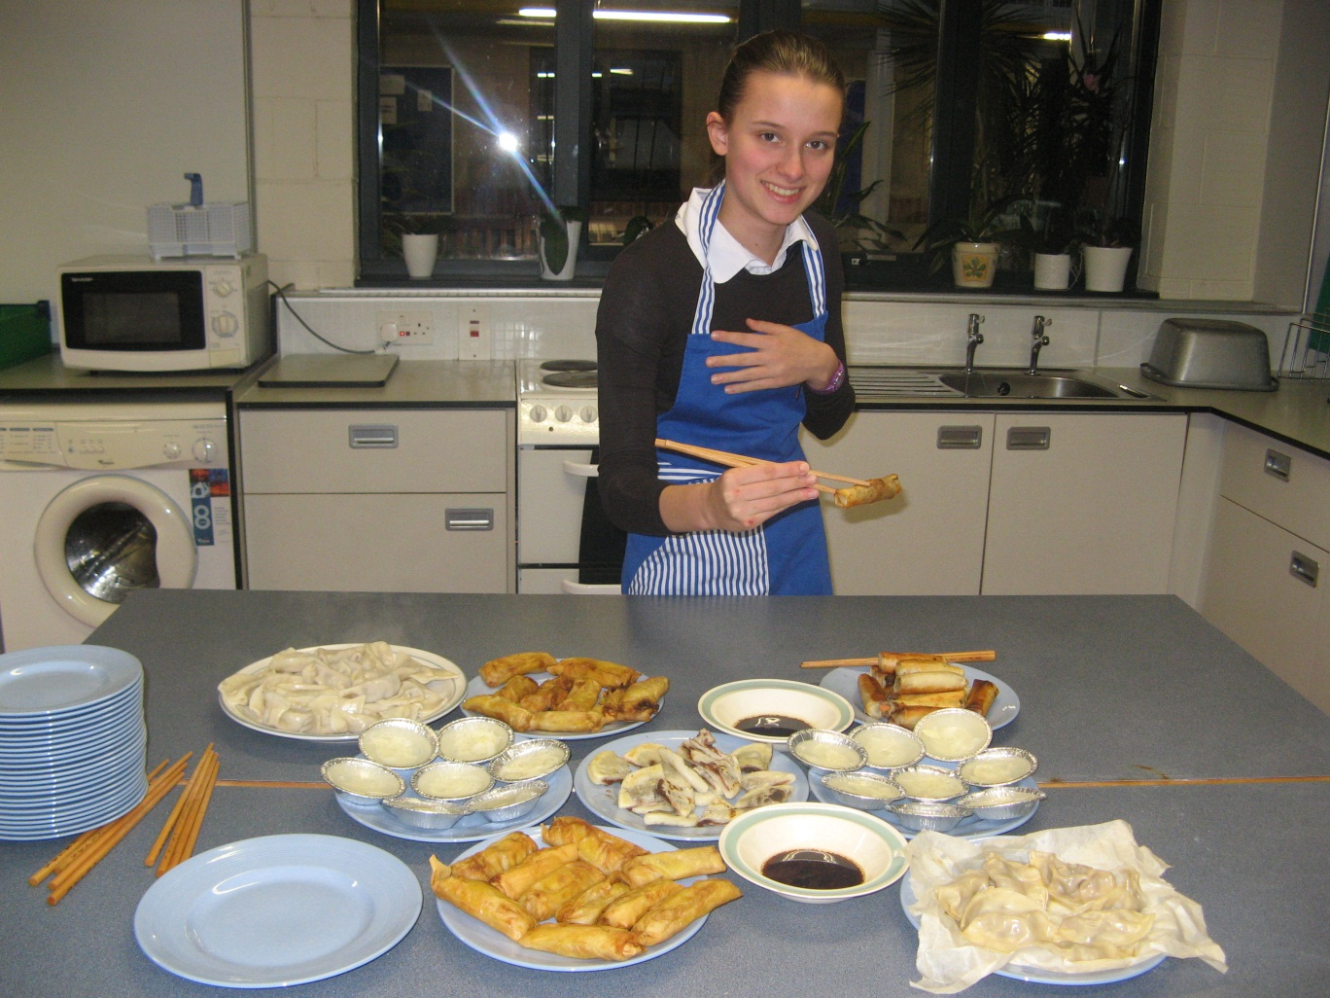
Outcomes:
1 They enjoyed the food they made
2 They knew how to cook Chinese food –skill CFE
3 More pupils came to join us
4 Teachers of HE enjoyed the experience

Slide 6
Example 2:
The Hot Seat with Modern Studies
Why?
1 My pupils were learning about Family.
2 MS were teaching the chapter about China.
3 Link –One Child Policy .

Slide 7
How?
1 Teacher sat on the hot seat.
2 Pupils were to ask different questions based on the topic or anything related.
3 Modern Studies teacher to assist their pupils’ questions.
Outcome:
1 It made pupils feel learning about China from a Chinese citizen was more realistic.
2 It made Chinese as a subject more connected with other subjects.
3 It made MS colleagues happy.

Slide 8
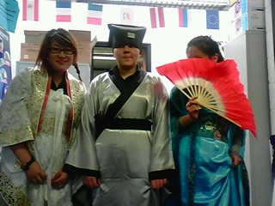
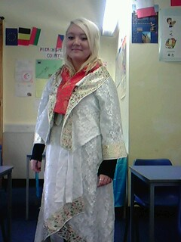
Example 3:
Chinese Art & Music
Origami
Chinese Painting
Chinese Fashion Show
Chinese Music
Taichi
* See additional photos given

Slide 9
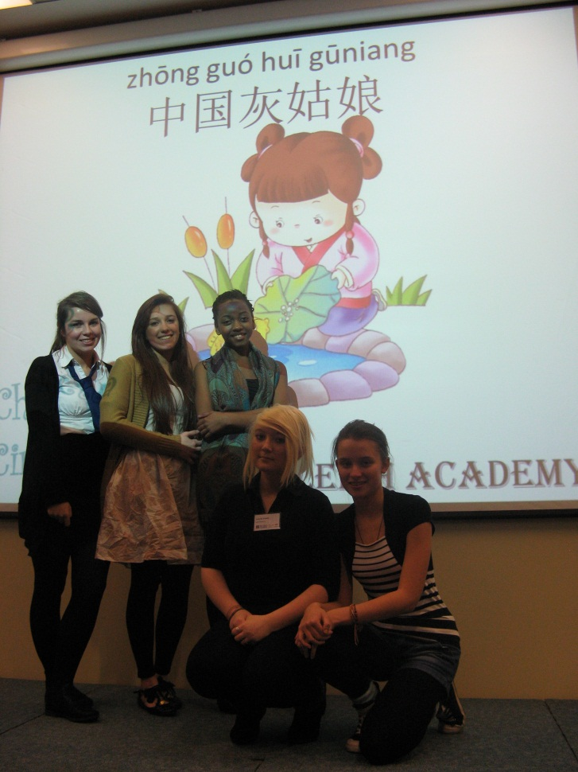
Chinese Drama:
British Council Mandarin Speaking Competition
A great way of working with drama teachers!
The lesson I learnt from my own pupils’ and other pupils’ performance!
Language + Acting

Slide 10
Example 4:
European Languages Week
*Easy, manageable & fun
How?
1 Card designing competition in all languages
2 Taught pupils numbers in different languages
3 Asked pupils to greet in different languages
4 Pupils introduced themselves in different languages
*Supporting colleagues in MS dept leads to good relationships and trust which is very important in creating interdisciplinary projects.

Slide 11
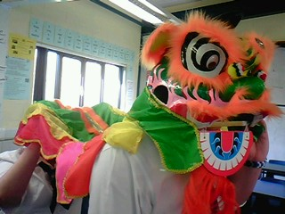
Example 5:
Carnival of Culture
Aims:
1 Raise awareness of culture differences
2 Promote Chinese and other cultures to wider
communities

Slide 12
Example 5:
Carnival of Culture
How?
1 Got help from parents, colleagues and pupils
2 Each was responsible for his own workshop
3 Mandarin teacher helped with pupils’
behaviour

Slide 13
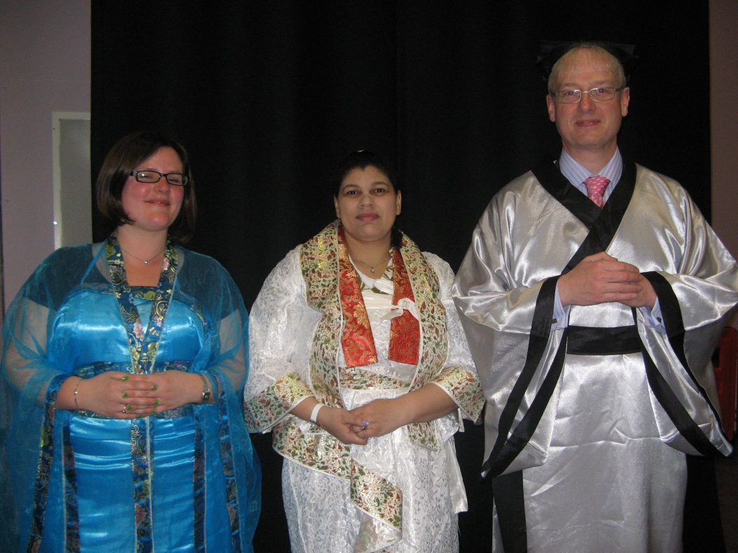
Example 5:
Carnival of Culture
Outcomes:
1 All the junior pupils enjoyed their experience and learnt something about China and Chinese art.
2 All the parents, teachers and pupils enjoyed their effort and contribution
3 Helped increase awareness of Chinese language across the community of school and parents

Slide 14
Cross-curricular benefits:
1 It is not about arbitrarily linking any subjects with Mandarin
2 It is about finding productive and effective links
3 It is to enhance learning in both subjects
4 It is putting pupils into a real life context
5 It is helping you to get to know other colleagues at school

Slide 15
Any questions?
谢谢
Xiè xiè

